Slide 1
P2015-0028
Lyme Adirondack Timberlands I, LLC
Agency Meeting: April, 2015

Slide 2
Overview
Proposal
Jurisdiction
Project Site
Silvicultural Treatments
Review Standards
Public Comment

Slide 3
Proposal

Slide 4
Proposal
Timber harvest on a 549 acre portion of a 16,159 acre tract.
Seven prescriptions, based upon stand conditions and desired outcomes:
Clearcut w/ Reserves, (65 ac)
Shelterwood Establishment (28 ac)
Free Thinning (31 ac)
Patch Clearcut (10 ac)
Seed Tree Establishment (7 ac)
Shelterwood Removal w/ Reserves (266 ac)
Uniform Shelterwood Removal (141 ac)

Slide 5
Jurisdiction

Slide 6
Jurisdiction
Class A Project in Rural Use and Resource Management 810(1)(d)(10) & 810(1)(e)(11)
“Timber harvesting that includes a proposed clearcutting of any single unit of land of more than twenty-five acres”

Slide 7
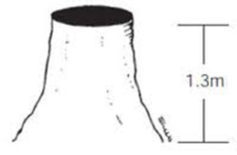
Jurisdiction
9 NYCRR Part 573.7(a)(1)
cutting of trees over 6 inches in dbh over any 10-year period, such that the average residual basal area of such trees after such cutting is less than 30 ft² /acre, measured within the area harvested …

Slide 8
Jurisdiction
If sufficient regeneration exists such that after the cut at least 30 ft²/acre of residual basal area remains, at least 10 ft²/acre of which is over 6” DBH, the harvest is not jurisdictional

Slide 9
Project Site

Slide 10
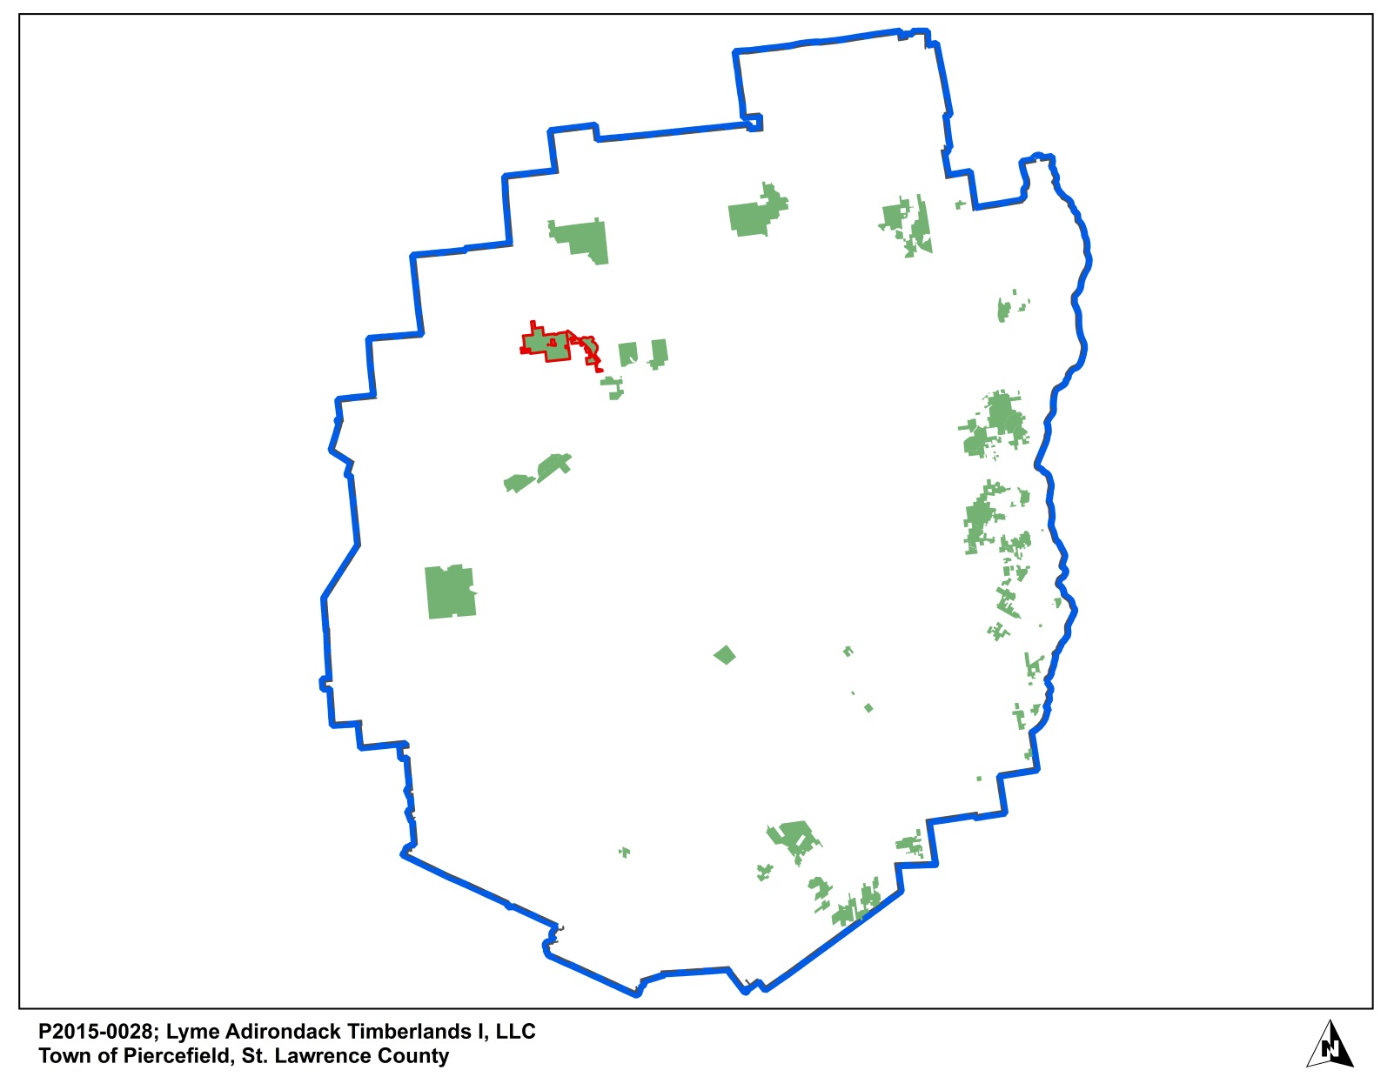
Slide Heading – Arial Bold
Copy (Arial Regular)
Notes:
The Lyme Timber Company is headquartered in Hanover, NH.
Lyme’s Adirondack forestlands consist of approximately 240,000 acres, located entirely within the Adirondack Park. These are the former International Paper forest tracts, purchased by Lyme in 2006. The properties consist of twenty-five tracts ranging in size from 750 acres to more than 26,000 acres. The project site is situated within the 16,159 acre Colton-Piercefield tract, in the Town of Piercefield, just north of New York State Route 3, and about nine miles west of the village of Tupper Lake.
You’ll recall the that this board has approved previous timber harvesting permits sponsored by Lyme in December, 2013, on the “Big Moose” tract in the Town of Webb, in July 2014 on the Altamont Tract outside of Tupper Lake, and in January of this year on the Robinwood tract in the Town of Long Lake.
All of these forests are certified to the Forest Stewardship Council and Sustainable Forestry Initiative forest management standards, and are subject to the conditions of a New York State Sustainable Forestry Conservation Easement.
Prentiss and Carlisle Forest Resource Management and Timberland Services is retained by Lyme to manage these Adirondack forestlands. Prentiss and Carlisle is headquartered in Bangor, ME, with New York offices in Queensbury, Chestertown and Tupper Lake.

Slide 11
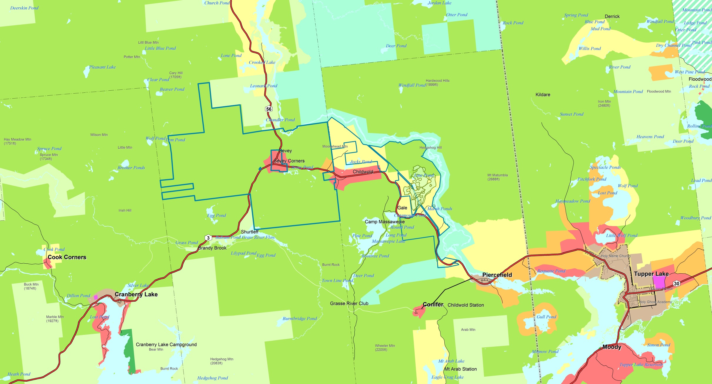
Section Title – Arial Bold
Notes:
General location map
Colton-Piercefield Tract outlined in blue
West of Tupper Lake
Point out County Line
Point out Piercefield Line and Colton Line
Raquette River Primitive Area
Dam Location
Adjoins other Resource Management Lands. These are non-residential lands, primarily dedicated to open space uses.
Site is accessed directly from an access gate off of NYS Route 3.

Slide 12
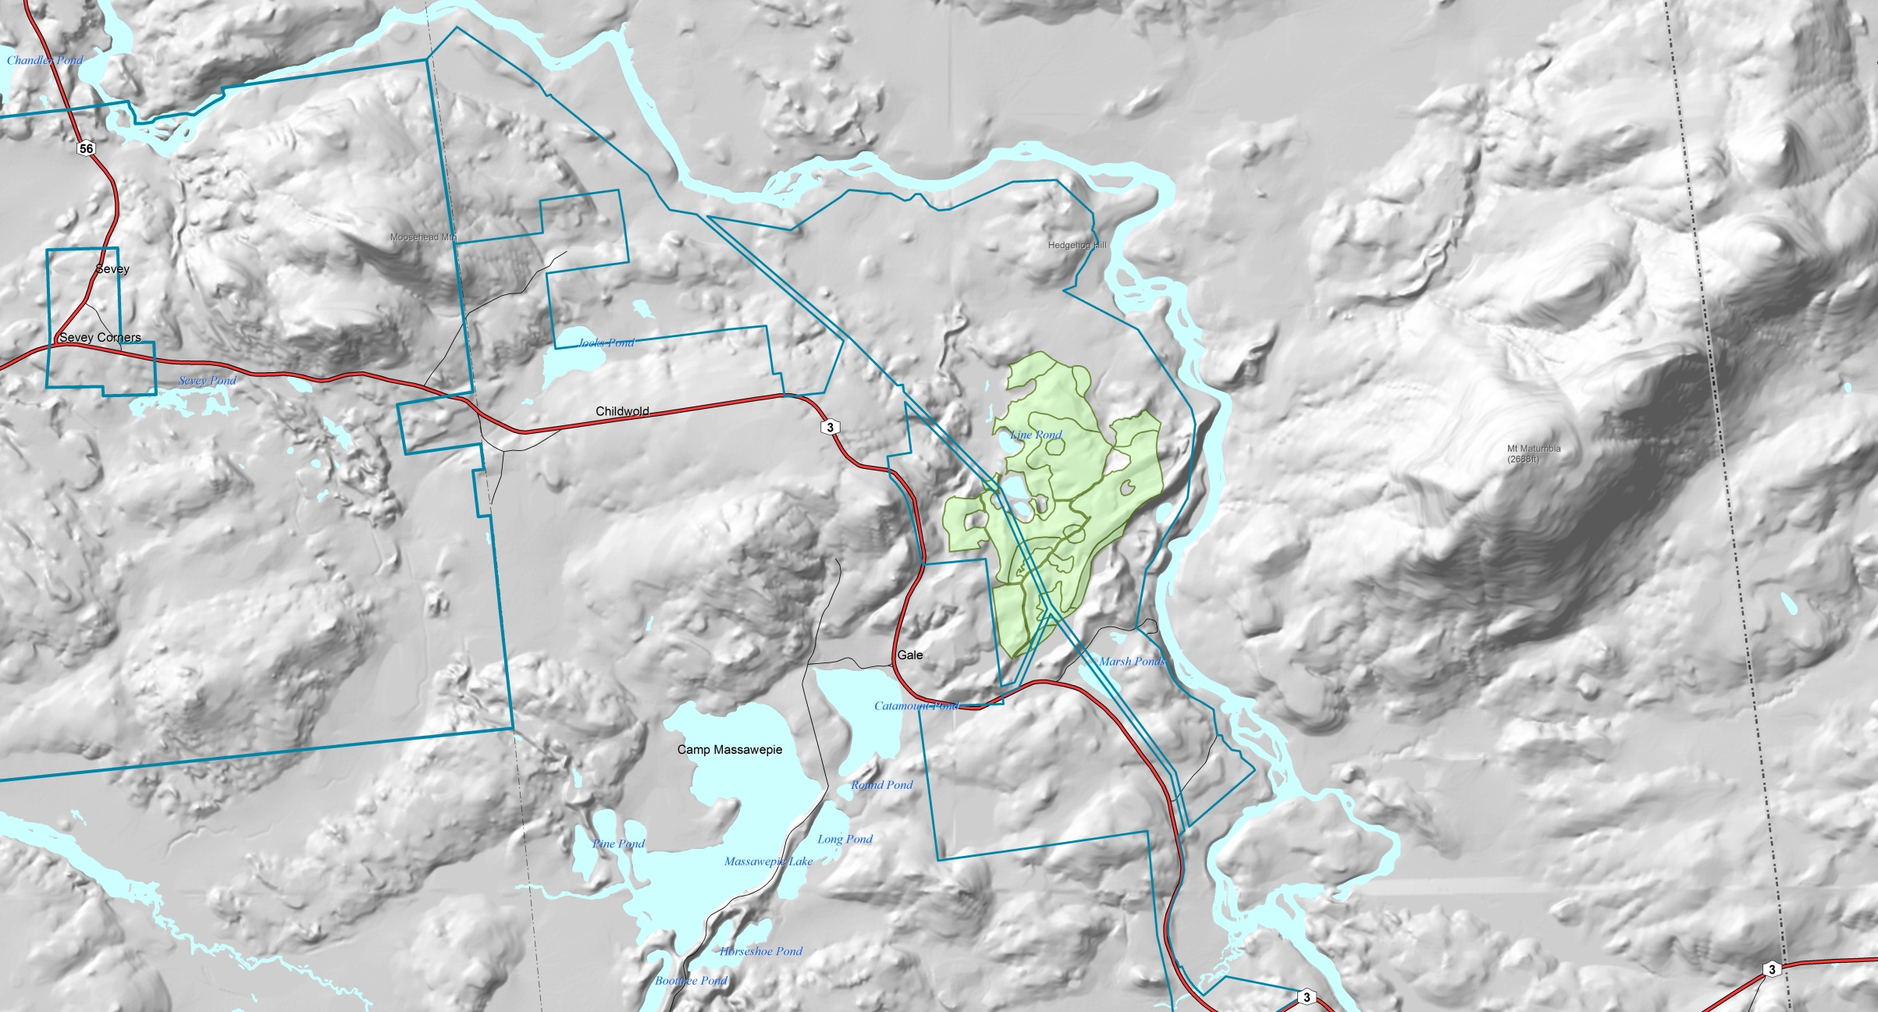
Section Title – Arial Bold
Notes:
Topography can be described as mostly flat to gently rolling.
There is one area of steep slopes here… There’s a better map coming up to show this area.
Mt. Matumbla to the east
The project site is shown in green. The lines within this shape are the different proposed harvest areas.

Slide 13
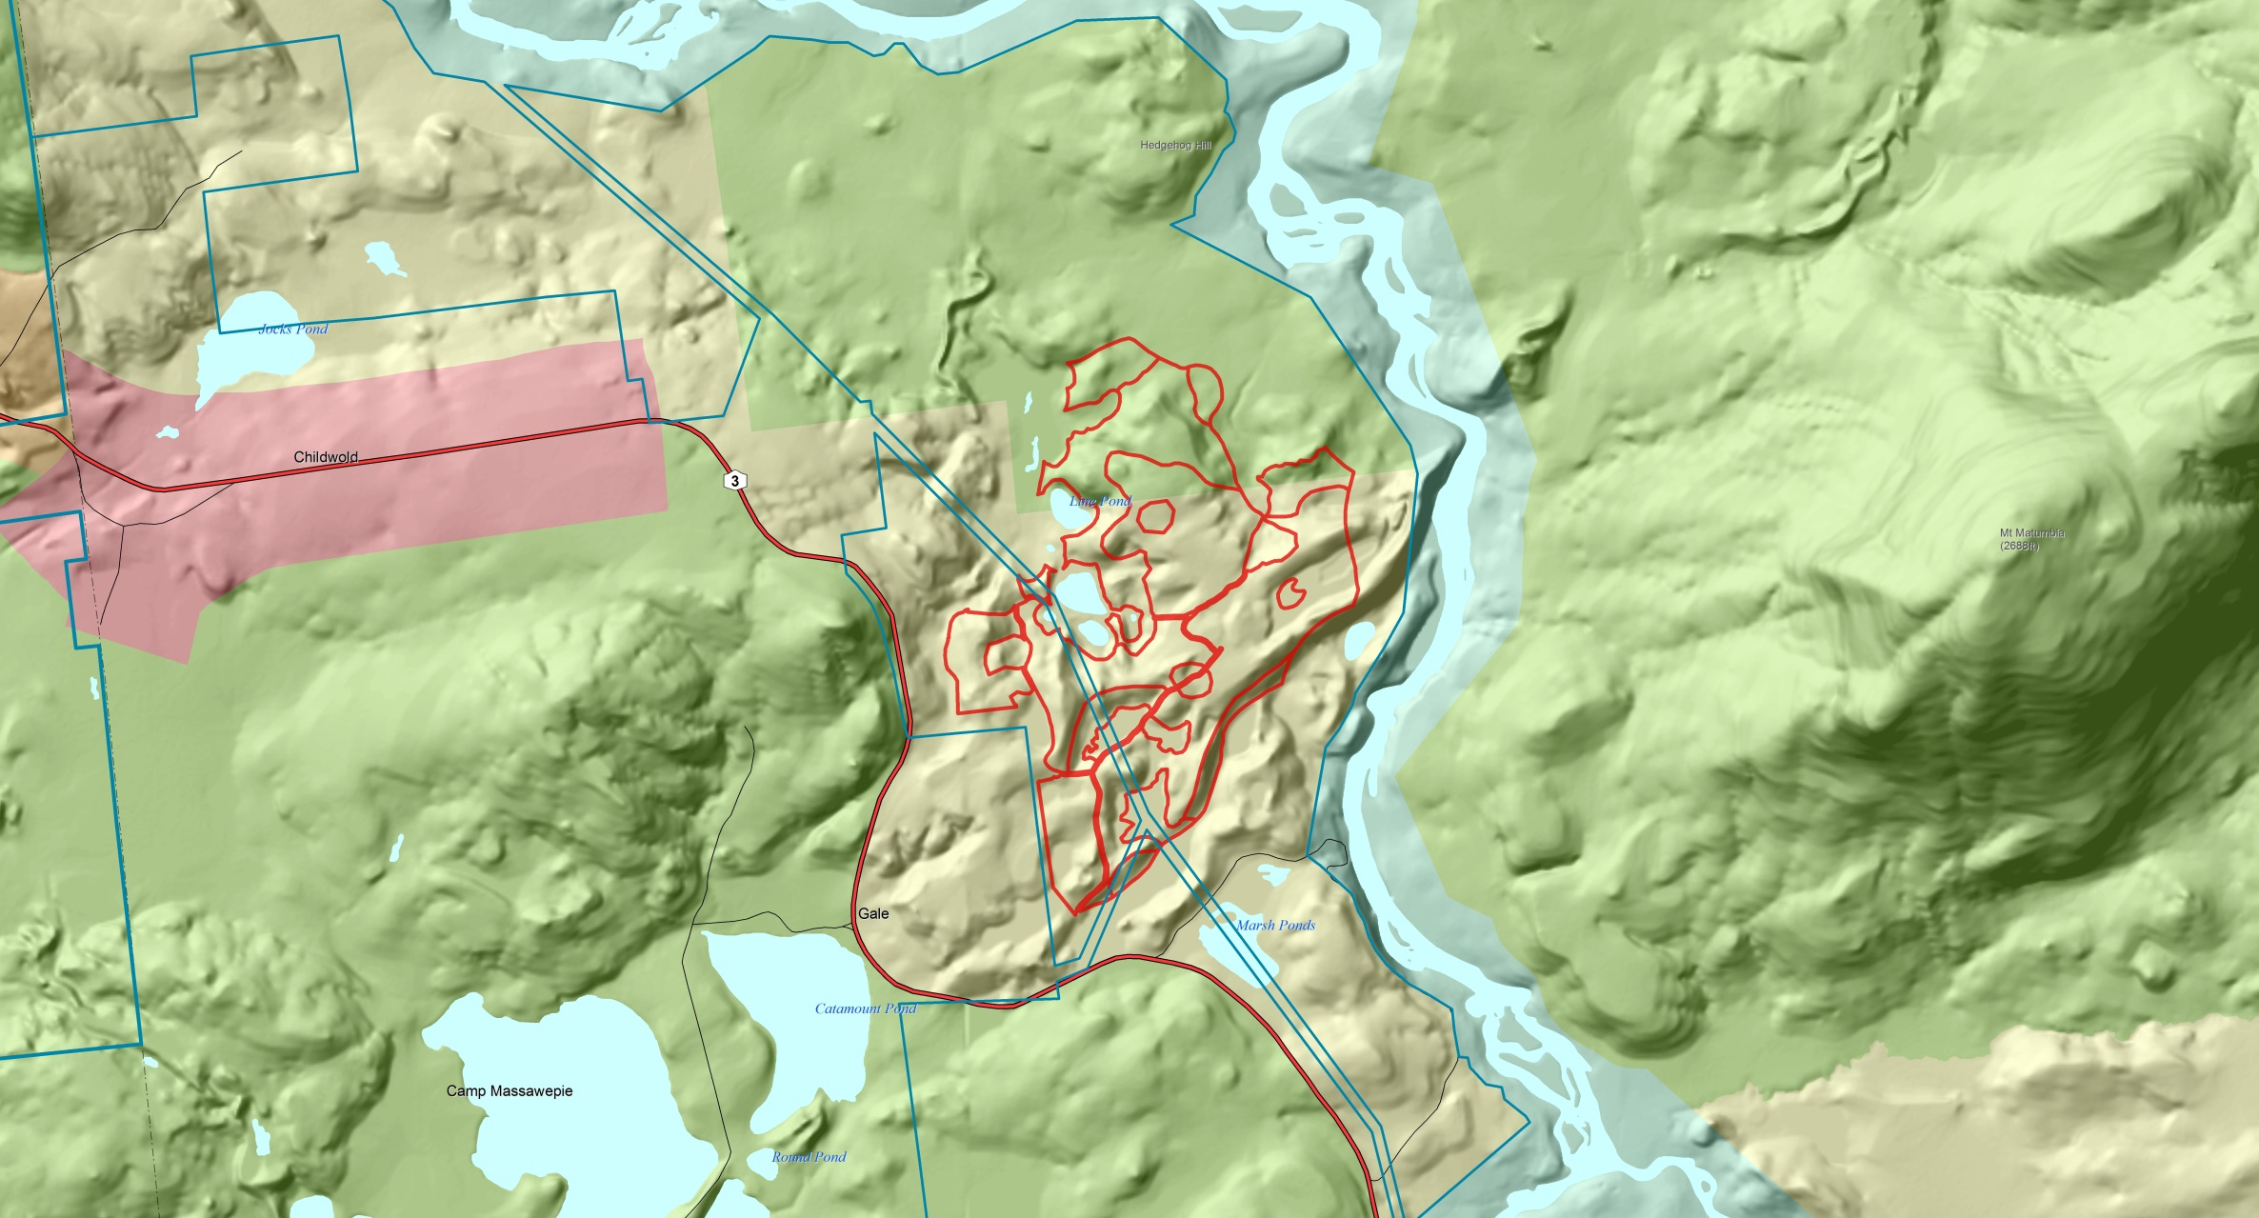
Section Title – Arial Bold
Notes:
The Colton-Piercefield tract is again outlined in blue. The harvest area is in red.
This map shows the land use boundaries within the project site, as well as the adjacent Raquette-Jordan Boreal Primitive area..
There are two properties adjoining the project site that are not owned by the applicant, to the southwest of the proposed harvest. These both contain sand and gravel mines, one privately owned and the other owned by the Village of Tupper Lake.

Slide 14
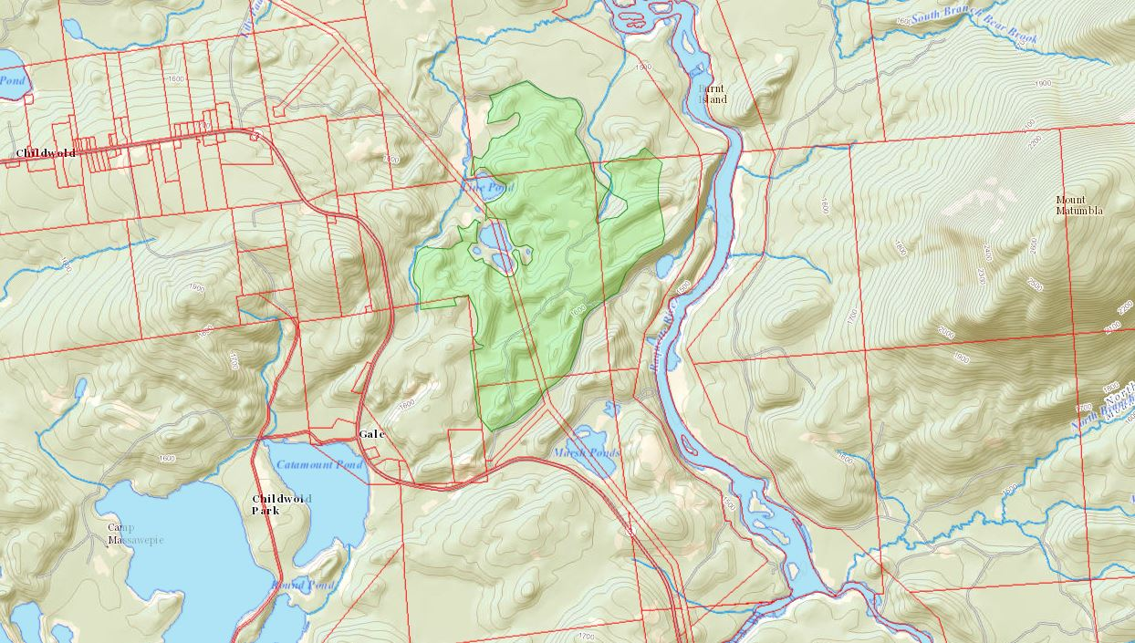
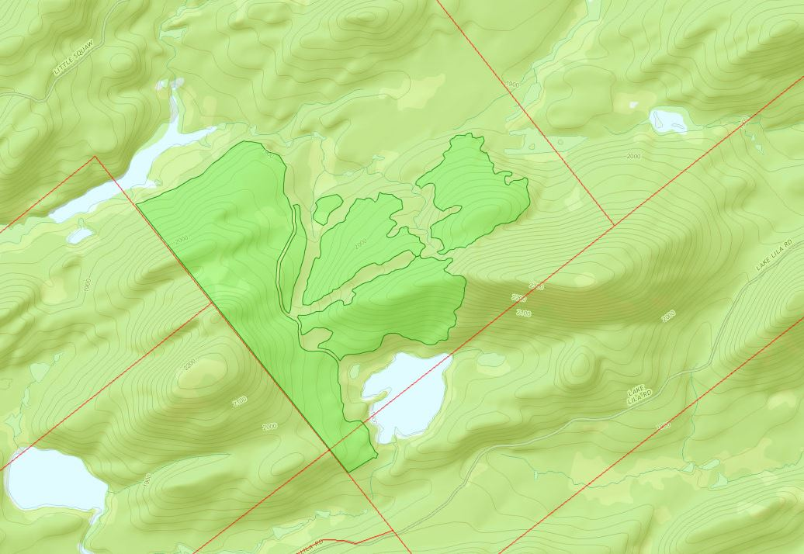
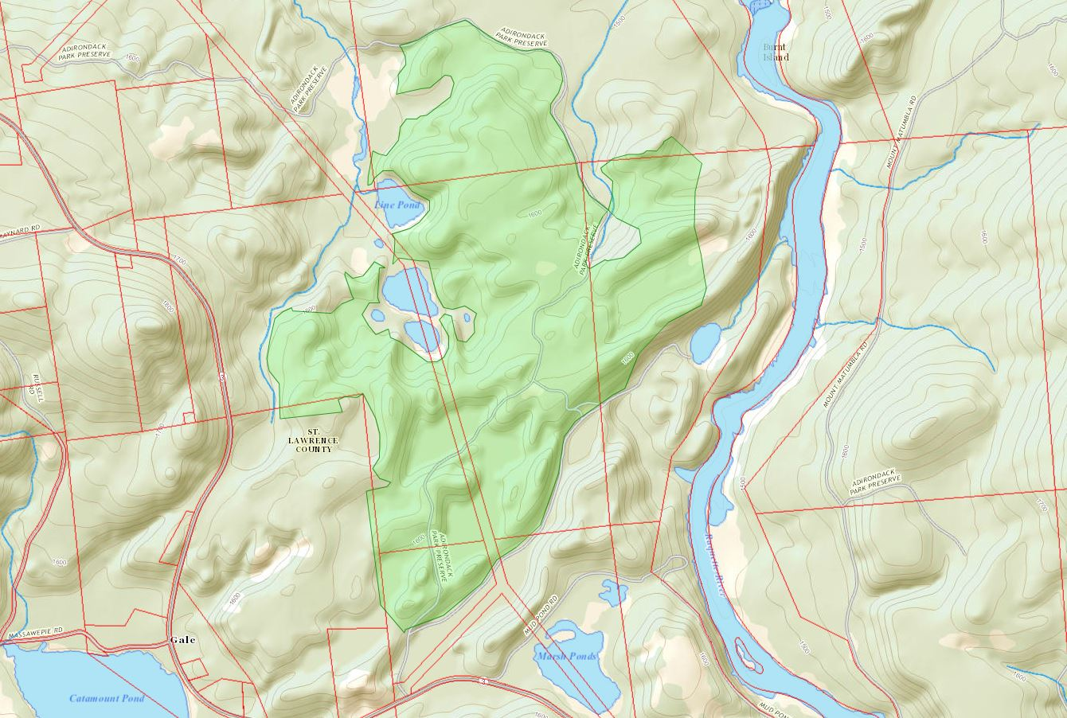
Section Title – Arial Bold
Notes:
Areas of the harvest site which approach adjoining property lines will be managed in accordance with the grievance resolution procedures contained in the forest management plan. These procedures include clear marking of property boundaries to prevent logging equipment from crossing into neighboring properties. 100 foot buffers to adjacent property lines will be observed. Limited at risk overstory trees may be removed from this area, but special care will be taken to insure that no tops or branches fall on the adjacent property, and regeneration will be carefully protected.
As mentioned, there are some areas of steep slopes. Skid trail access in these areas will be established using best management practices, primarily parallel to slope. This area is targeted for a shelterwood establishment treatment, so the harvest there will be significantly lighter than elsewhere on the project site.
Portions of the harvest may be visible from heights of land on neighboring properties, and from Mt. Matumbla. There may be a brief glimpse of the project site traveling eastbound on Route 3, but by and large the site will not be visible from the road.

Slide 15
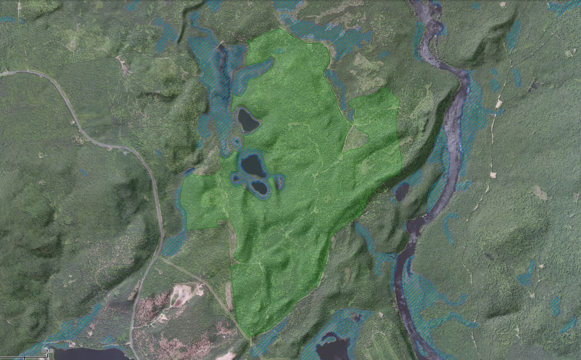
Notes:
An existing road network is accessed directly from the north side of Route 3. Minor maintenance will be required prior to the harvest.
There are no wetlands, streams or other waterbodies on the project site. The soils are very well drained and very sandy.
The harvest boundary has been delineated to exclude adjacent wetlands from the operations area.
Within 100 feet of wetlands, which in this case are not on the project site, a Riparian Management Zone (RMZ), wherein cutting and operation of machinery is limited, will be established and maintained. The RMZ is standard practice for Lyme Timber as outlined in their Forest Management Plan. The applicant also applies the New York State Forestry Best Management Practices for Water Quality within these zones.

Slide 16
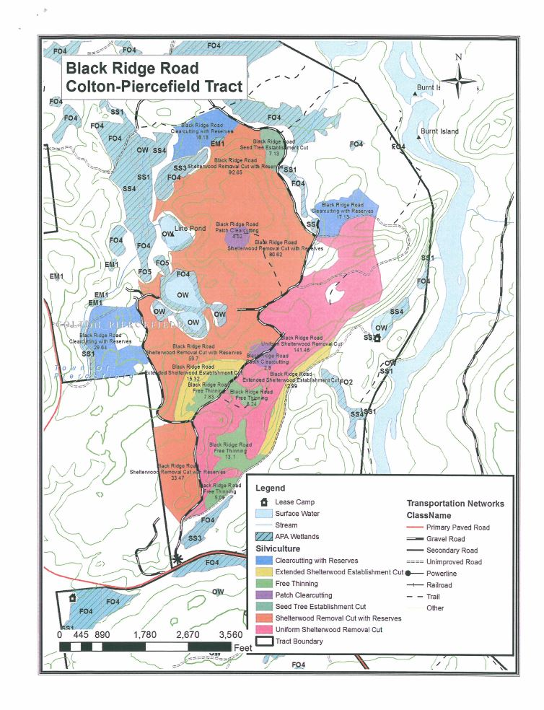
Notes:
This is the project harvest plan and site map. This map is attached to the draft permit you have before you.
These boundaries are field delineated with a high precision, high accuracy GPS by a Prentiss and Carlisle forester.
The proposed harvest area was last cut in 2004 and 2005 by the previous owner. Within most of this area, past partial harvests have created a fairly uniform overstory with small, medium and large saw timber sized sugar maple that now has significant crown damage
The current proposal is a continuation of Lyme’s efforts to increase age and species diversity across their managed lands. The management is designed to remove declining growing stock, and create the conditions for healthy, vigorously growing stands.
The project sponsor has again stressed that much of this proposal could, with very minor revisions, be done while leaving greater than 30 ft² average per acre of basal area across the area harvested, but doing so would require leaving behind a higher percentage of undesirable stems, to the detriment of the future forest. Lyme Timber is seeking the Agency permit so they have the flexibility to practice sound, sustainable forestry, without concern for tripping the jurisdictional threshold.

Slide 17
Silvicultural Treatments

Slide 18
Silvicultural Treatments – 1
Clearcutting with Reserves (64.96 acres):
Overstory is sugar maple, red maple, cherry and beech
Significant crown dieback in sugar maple
Well-established regeneration → 80% beech

Slide 19
Silvicultural Treatments – 1
Harvest Prescription (Clearcut w/ Reserves):
Retain all yellow birch, and all healthy stems of sugar maple, black cherrry and red spruce as seed source (10 ft²/acre BA)
Retain all stems over 25” dbh as future snag trees
Remove or knock down as much beech as possible, especially in vicinity of retained seed trees, to provide openings for new species to compete

Slide 20
Silvicultural Treatments – 2
Extended Shelterwood Establishment (28.31 acres)
Overstory is cherry, sugar maple, red maple, and beech
Significant crown dieback in sugar maple. Red maple and beech are diseased or have poor crowns
Well-established regeneration → 80% beech

Slide 21
Silvicultural Treatments – 2
Harvest Prescription (Shelterwood Establishment):
Residual BA 35 – 45 ft²/acre of healthy black cherry. Healthy red maple and sugar maple will also be retained
Retain snag and cavity trees where possible
Harvest all beech, and stems displaying disease, canker or poor crown health

Slide 22
Silvicultural Treatments – 3
Free Thinning (31.25 acres):
Overstory is balsam fir, red spruce, white pine, black cherry, red maple, sugar maple and yellow birch
Softwoods have good form and health. Hardwoods have poor form, defects and unhealthy crowns
Regeneration dominated by balsam fir and red spruce. Smaller quantities of hardwood interspersed.

Slide 23
Silvicultural Treatments – 3
Harvest Prescription (Free Thinning):
Harvest all hardwoods displaying disease, canker, severe defect or poor crown health
Retain all yellow birch. Retain healthy hardwoods. Retain healthy white pine
Residual stand → 40-50 ft²/acre of healthy balsam fir, spruce, cherry, maple, birch and white pine

Slide 24
Silvicultural Treatments – 4
Patch Clearcutting (9.54 acres):
Proposed for landing locations, to open areas large enough for operations and stocking
Overstory is sugar maple, red maple, black cherry and beech
Regeneration → 80% beech

Slide 25
Silvicultural Treatments – 4
Harvest Prescription (Patch Clearcutting):
Harvest all merchantable stems
Knock down beech regeneration as much as possible
Open sites for landings

Slide 26
Silvicultural Treatments – 5
Seed Tree Establishment (7.13 acres):
Overstory is red maple, black cherry, yellow birch, hemlock, red spruce, balsam fir and sugar maple
Stand lacks healthy, quality overstory trees, but species diversity is favorable for seed tree retention

Slide 27
Silvicultural Treatments – 5
Harvest Prescription (Seed Tree Establishment)
Target residual basal area → 10-15 ft²/acre
Beech regeneration will be removed or run down
Desirable regeneration (yellow birch, cherry, spruce/fir) will be protected

Slide 28
Silvicultural Treatments – 6
Shelterwood Removal with Reserves (266.4 acres):
Overstory is sugar maple, red maple, black cherry, beech, red spruce, hemlock and yellow birch
Significant crown dieback in sugar maple. Red maple and beech are diseased or have poor crowns.
Regeneration → 80% beech

Slide 29
Silvicultural Treatments – 6
Harvest Prescription (Shelterwood Removal with Reserves):
Harvest all merchantable stems 6” dbh and larger
Retain all yellow birch and all healthy black cherry and red spruce 6” – 10” dbh for seed source and vertical structure
Beech understory around desirable seed sources will be knocked down

Slide 30
Silvicultural Treatments – 7
Uniform Shelterwood Removal (141.46 acres) :
Overstory is sugar maple, red maple, black cherry and beech
Significant crown dieback in sugar maple. Red maple and beech are diseased or have poor crowns
Lack of desirable seed trees
Regeneration → 80% beech

Slide 31
Silvicultural Treatments – 7
Harvest Prescription (Uniform Shelterwood Removal):
Harvest all merchantable stems 6” dbh and larger
Retain yellow birch (very little present)
Beech will be released to grow freely (forest continuity)
Beech will be knocked down in vicinity of the few desirable seed sources

Slide 32
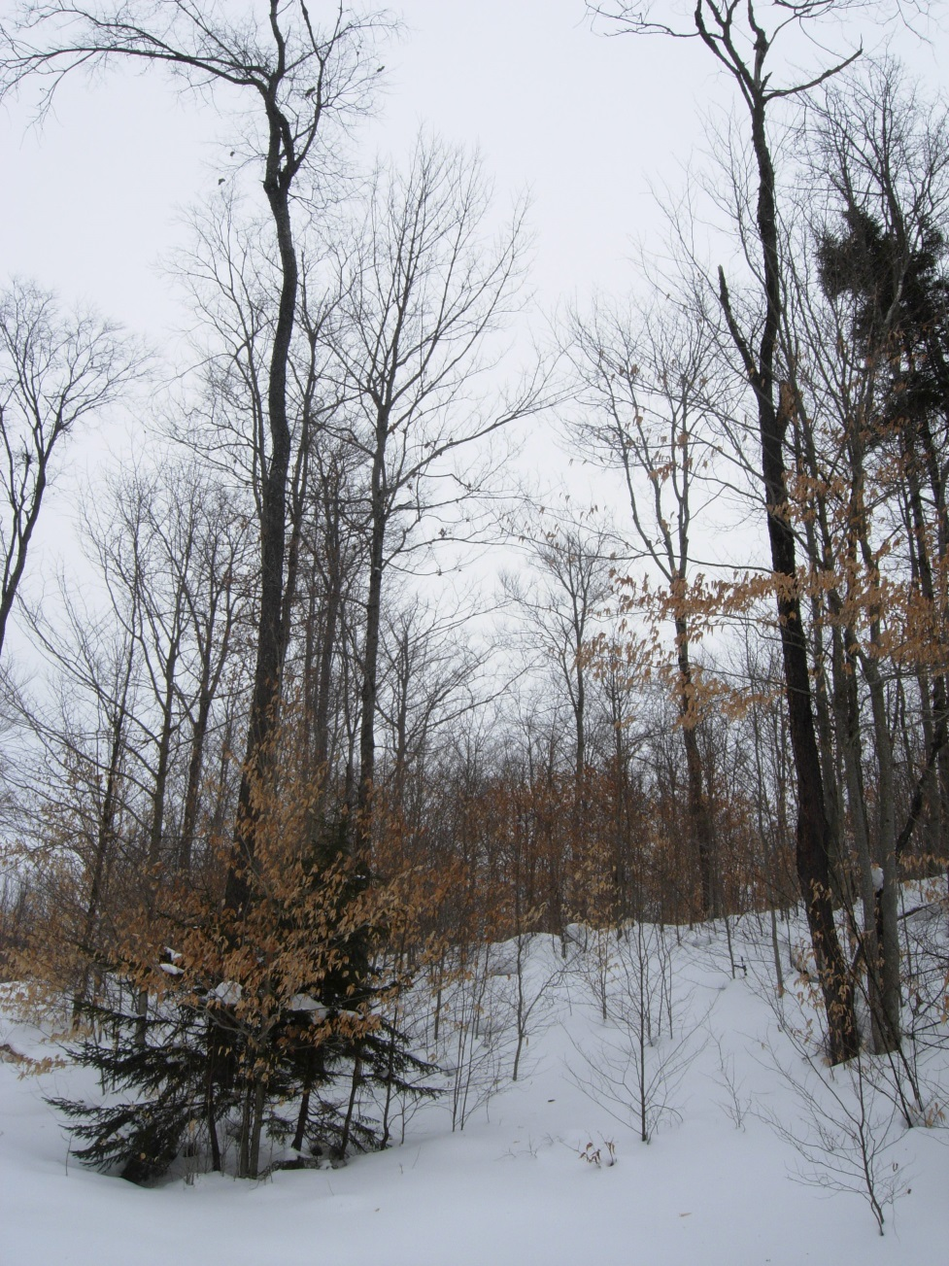

Slide 33
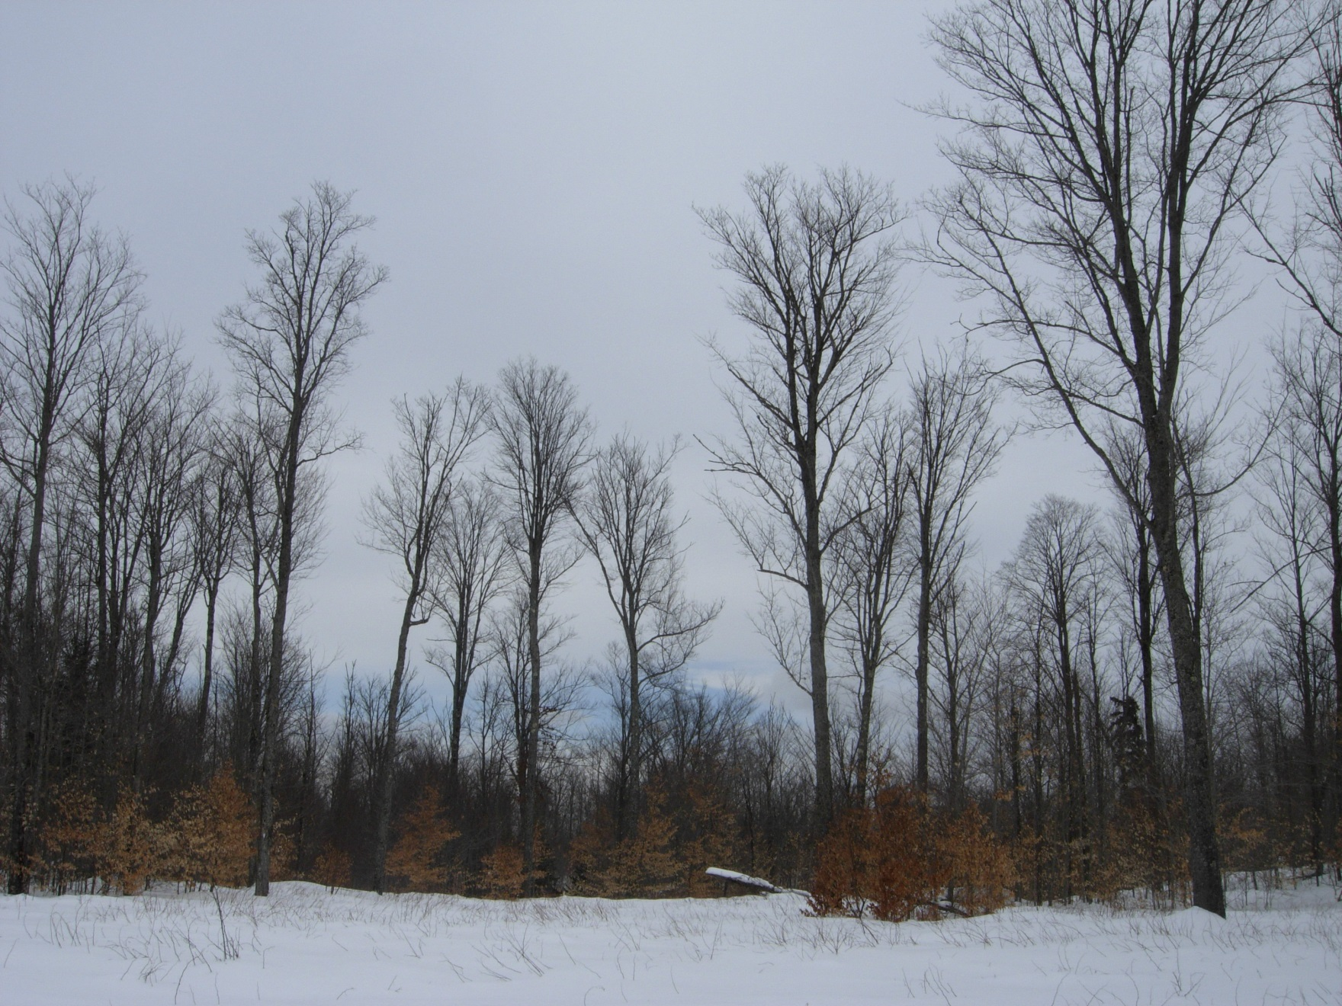

Slide 34
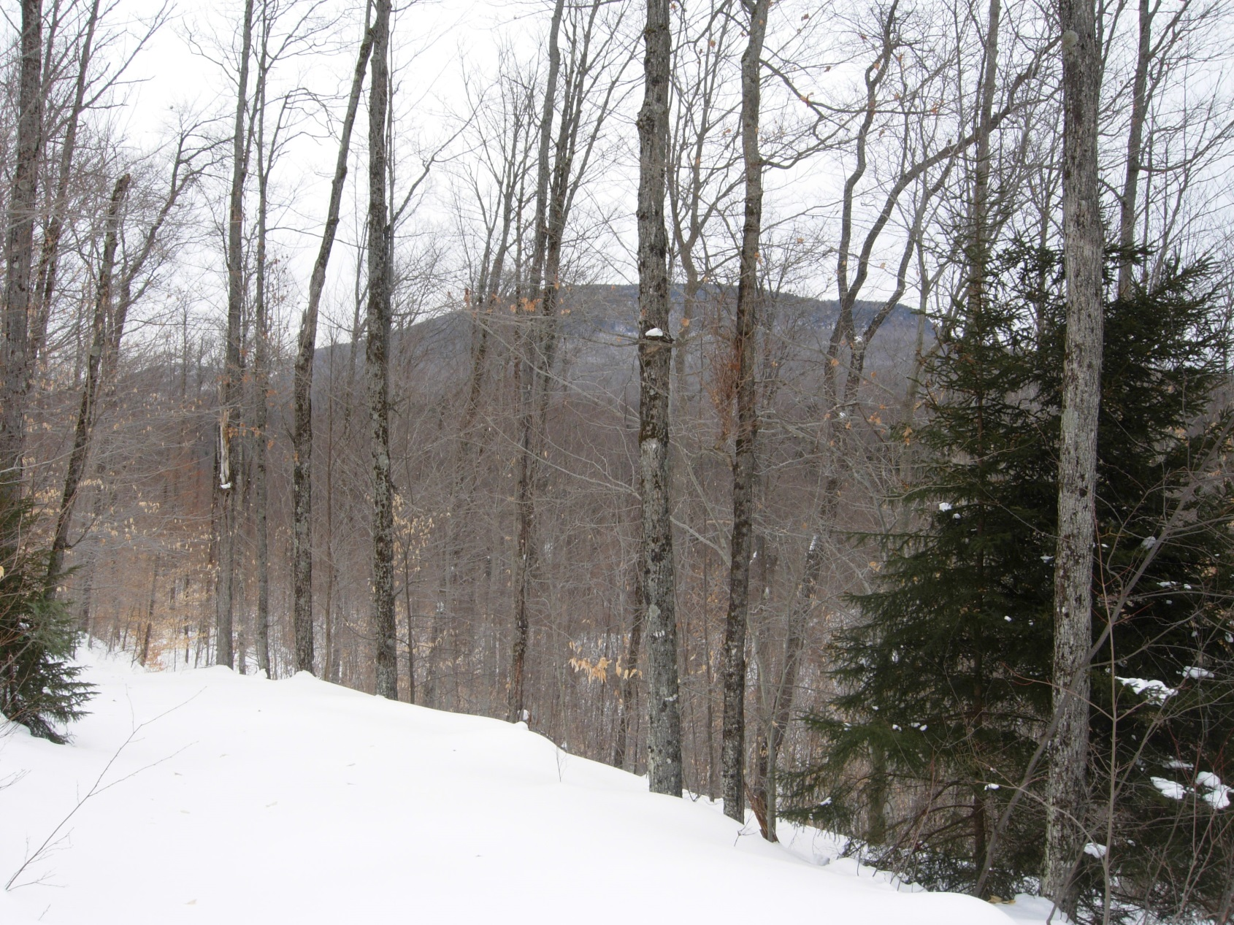

Slide 35
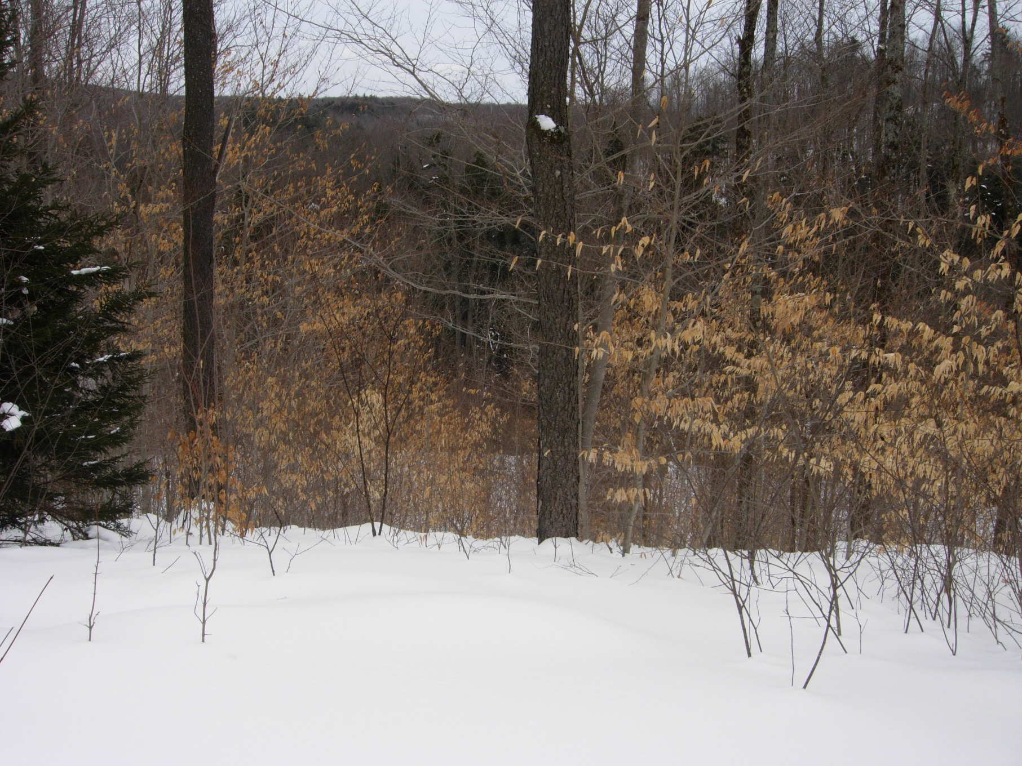

Slide 36
Review Standards

Slide 37
Review Standards
the clearcutting is for a recognized silvicultural purpose;
there are adequate buffers on the shorelines of lakes, ponds, rivers or streams; along major travel corridors, and, if necessary, around dwellings on adjacent lands, so as to preserve water quality and visual quality and to control noise;
habitats of rare and endangered species and other key wildlife habitats will be protected;

Slide 38
Review Standards
regeneration of timber is assured;
if proposed, and if allowed by the agency, any use of pesticides and herbicides will be strictly controlled;
harvest will be controlled by qualified personnel by contract, marked stand, direct supervision, or other adequate means;

Slide 39
Review Standards
wood roads and skid trails will be located, and equipment will be operated, so as to minimize erosion on slopes and elsewhere;
the storage, mixing, or bulk handling of fuel, chemicals, or other hazardous materials will be strictly controlled;
the latest edition of the New York State Forestry Best Management Practices for Water Quality: BMP Field Guide will be adhered to, at a minimum.

Slide 40
Public Comment
Notes:
One letter was received, from Dan Plumley and Dave Gibson at Adirondack Wild.
The letter focused primarily on general suggestions for improvement of the Agency’s review of jurisdictional timber harvests, and was very much in line with the ongoing discussions we’ve been having with the Silvicultural Practices roundtable group.
Specific to this project, the letter addressed concerns about rare threatened or endangered species, wetland protections, and permit compliance review.
Staff believe these questions have been adequately addressed in our review.

Slide 41
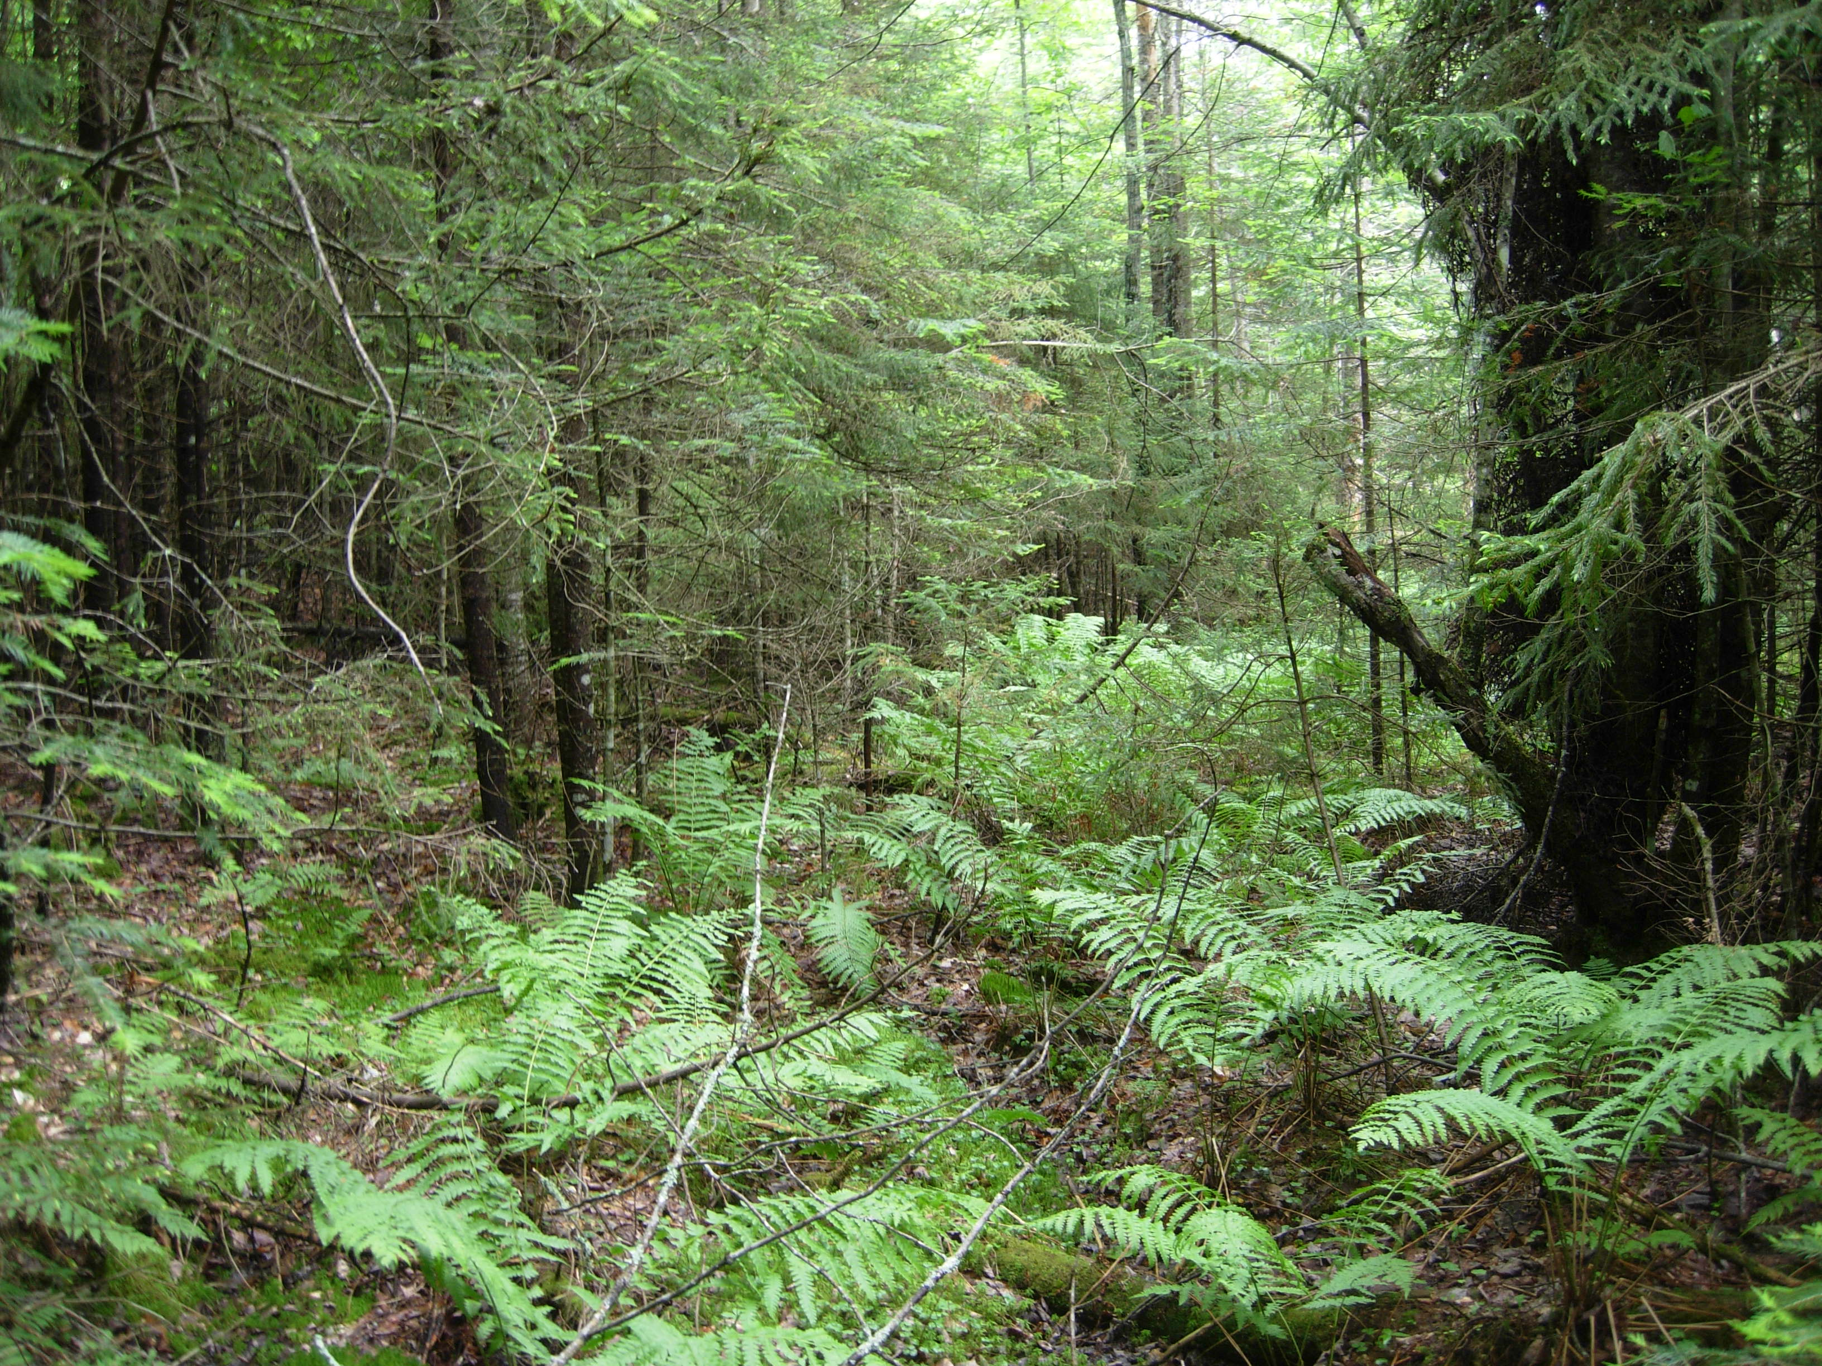
P2015-0028
Lyme Adirondack Timberlands I, LLC
Staff Recommendation: Approve with Conditions
Notes:
We all need to see some green…….

